Slide 1
FARM PRODUCTION
& PROFITABILITY
5,000 records • Nigerian naira (₦)
Prepared by Adepelumi

Slide 2
EXECUTIVE SUMMARY
The story in four numbers
The dataset reports high overall returns; the next step is to verify what drives them.
REVENUE
PRODUCTION COST
PROFIT
PROFIT MARGIN
₦45.86bn
₦11.89bn
₦33.97bn
74.1%
Recorded sales
Recorded costs
Revenue less cost
Weighted margin
What stands out
Main cost pressure
Decision
Tomato leads total crop profit.
Labour is the largest cost category.
Compare profit per hectare before expanding.
Note: workbook records are labelled synthetic/simulated.
02

Slide 3
DATASET
What the dataset covers
The analysis combines farm conditions, production outcomes and financial measures.
FARM RECORDS
FIELDS
TOTAL PRODUCTION
5,000
27
136.3k t
Rows in supplied workbook
Columns / variables
Recorded tonnes
Farm profile
Production
Financials
State, region, crop, farm size and experience.
Season, irrigation, fertiliser and other inputs.
Cost, revenue, profit and margin.
Interpretation: useful for exploring patterns, but not proof of real-world national performance.
03

Slide 4
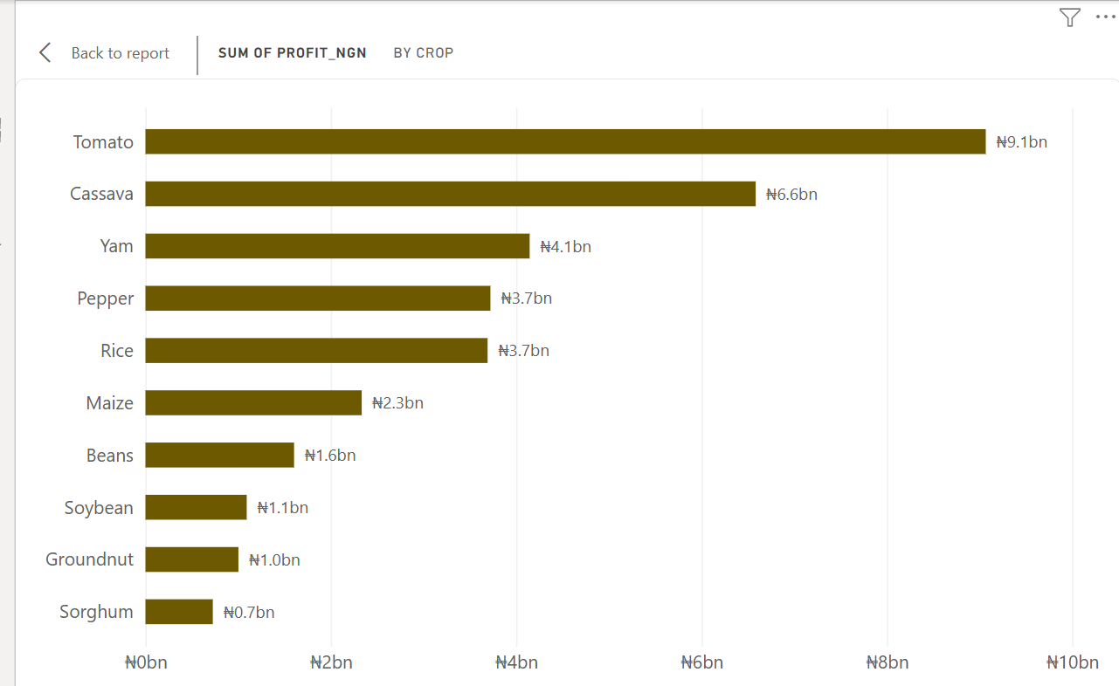
CROP PERFORMANCE
Tomato leads total crop profit
Total profit reflects both crop economics and the scale of production.
Top crop: Tomato
₦9.07bn total profit
₦4.81m profit per hectare
Lowest total profit: Sorghum
₦726.9m total profit
Recommendation: compare yield, selling price and cost per hectare before changing crop allocation.
04

Slide 5
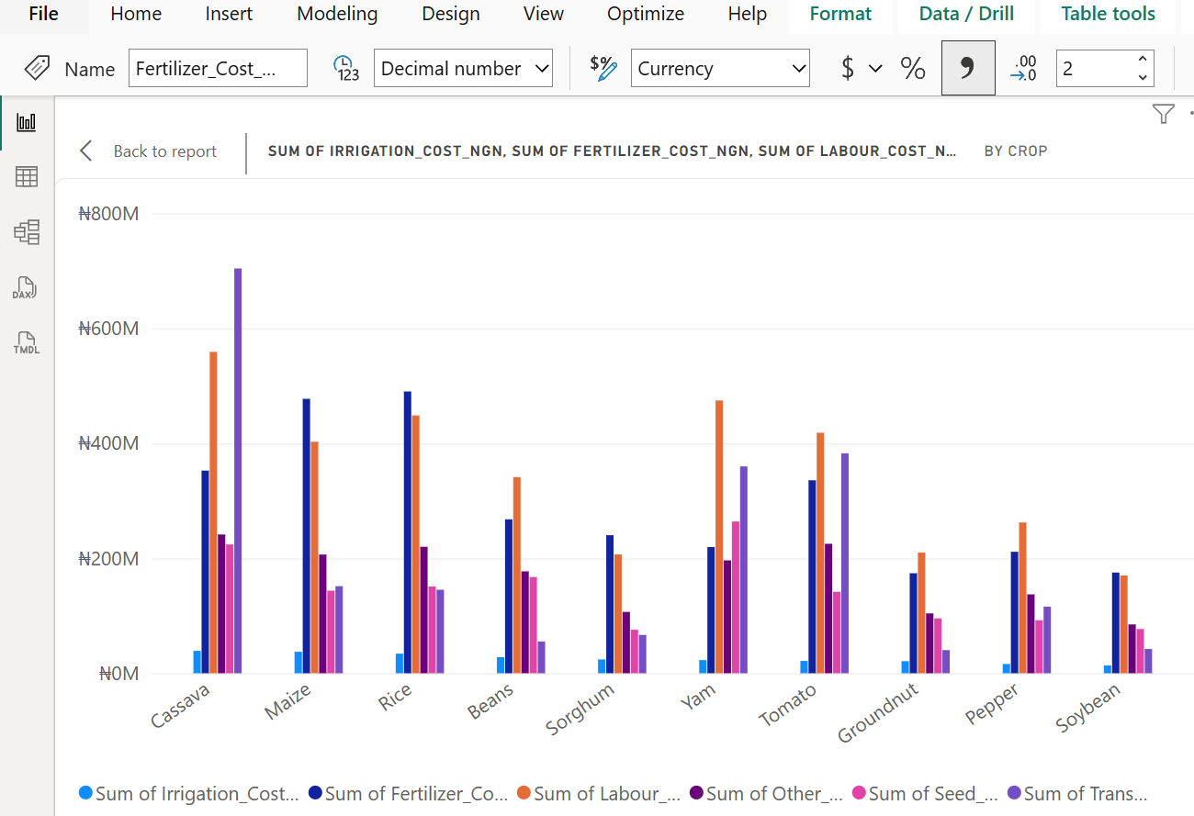
COST DRIVERS
Focus cost control on three categories
Labour, fertiliser and transport together make up a large share of recorded costs.
Labour
₦3.49bn • 29.4% of cost
Fertiliser
₦2.94bn • 24.8% of cost
Transport
₦2.06bn • 17.4% of cost
Recommendation: track cost per hectare and per tonne; negotiate rates and improve planning without reducing yield.
05

Slide 6
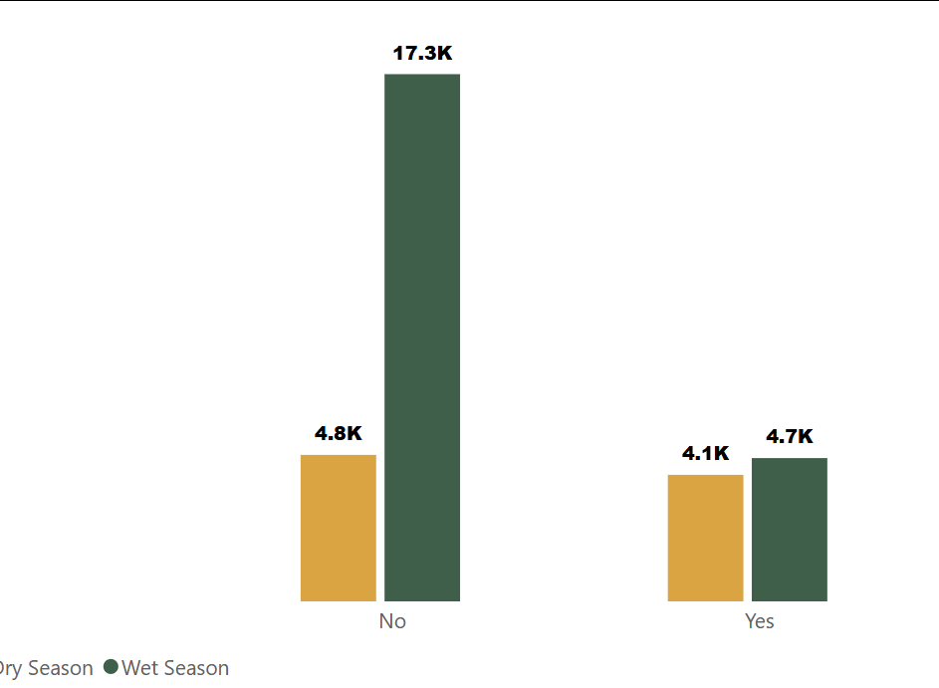
YIELD
Irrigated records show higher average yield
The pattern appears in both seasons, but does not prove irrigation alone caused the difference.
Recommendation: pilot irrigation and include water, energy and maintenance costs.
06

Slide 7
GEOGRAPHIC PERFORMANCE
Regional totals need a fair comparison
Total profit and profit per hectare answer different questions.
Highest total profit
Highest profit / hectare
Top state by total profit
North Central
₦7.90bn
North West
₦1.59m/ha
Ogun
₦1.48bn
Recommendation
Compare crop mix, selling price, yield and cost per hectare before transferring practices between locations.
07

Slide 8
MARKET ACCESS
Test logistics before investing in storage
Storage status alone does not show storage quality, capacity or losses prevented.
AVERAGE PROFIT WITH STORAGE
AVERAGE PROFIT WITHOUT
LOSS-MAKING RECORDS
₦6.79m
₦6.80m
2
Per record
Per record
Investigate costs and prices
What the data suggests
What to do
Average profit is almost the same across storage groups.
Trial shared transport or collection points; measure cost per tonne and spoilage.
08

Slide 9
ACTION PLAN
Recommended next steps
Start with actions that are measurable and relatively easy to test.
Prioritise Profitable Crop
Control the Biggest Costs
Invest in Irrigation Strategically
Reduces Transport Expenses
Investigate Loss-Making Farms
09

Slide 10
THANK YOU
Prepared by Adepelumi

